Slide 1

Kitchen Layout and Arrangement Prototype
A U A D Case S t u d y - Deepa Varghese

Slide 2
What needs to be built
Basic building block
Floor
Counter-top
Individual pieces
Testing pieces

Slide 3
Basic Building Block

Slide 4
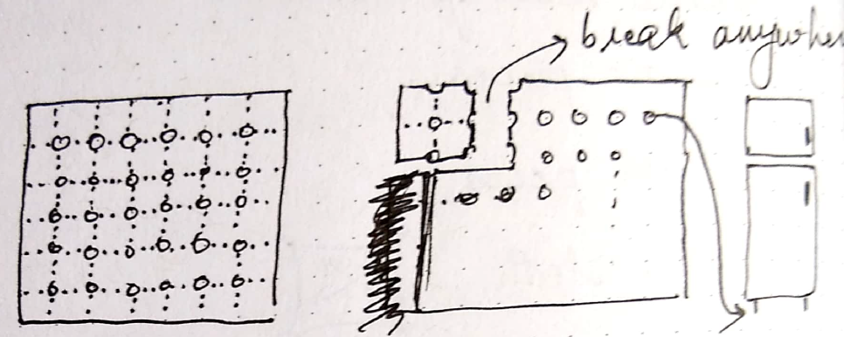
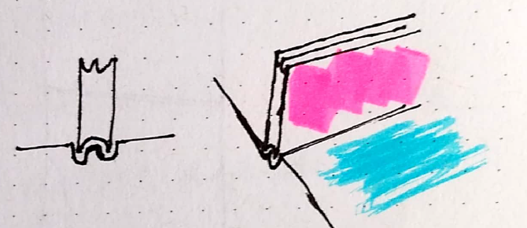
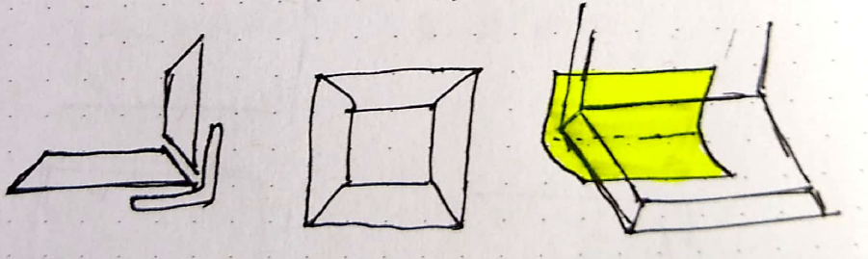
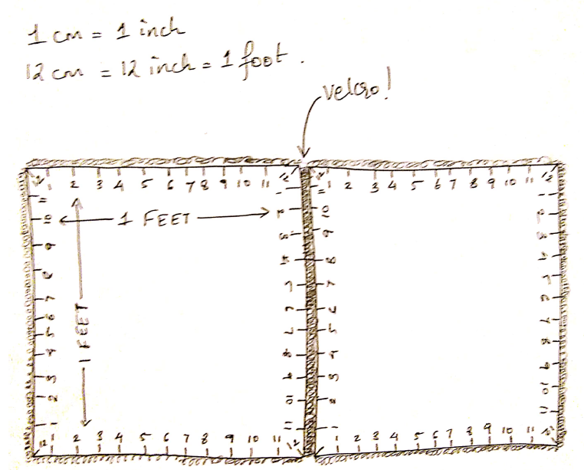
Sketching
Iterations
Final Design

Slide 5
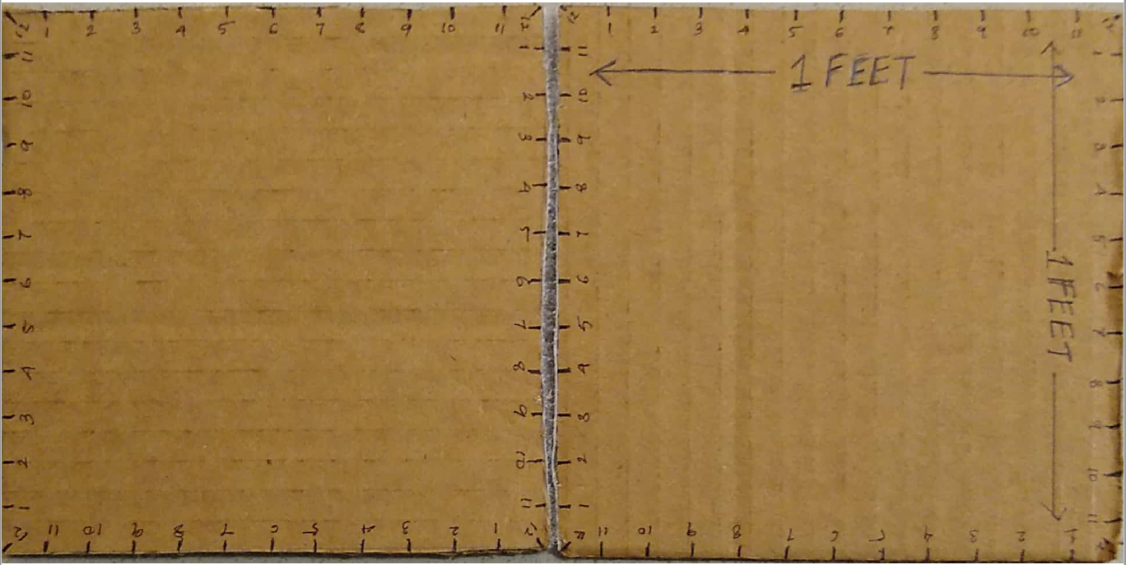
Prototype
My first instinct with the final design was to use magnets at the edges of a block
But because of their questionable effects on prolonged use, I had to look for something else
Double-sided tape -> glue -> puzzle edges -> velcro

Slide 6
Issues highlighted by Prototyping
Each block is thin enough to not let its own dimensions create a confusion about the measurements in the layout. Due to this, Velcro isn’t strong enough to hold each block together, vertically. Neither would magnets.

Slide 7
Floor

Slide 8
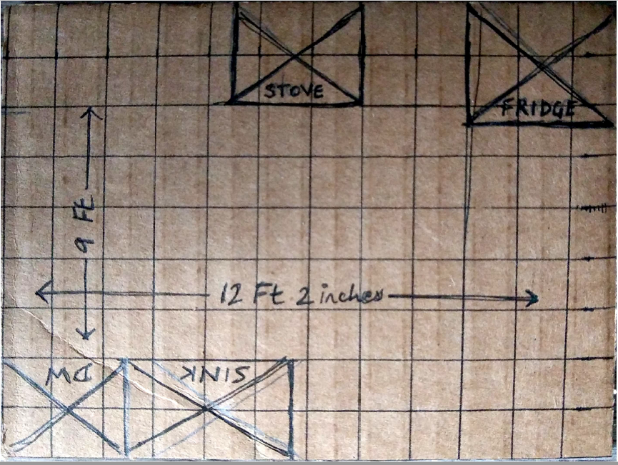
Prototype
Once the floor is ready you can draw over it using the measurements already marked on each block to decide where everything goes

Slide 9
Issues highlighted by Prototyping
I didn’t think about walls. People might want to mount things on the wall when they find they don’t have enough space on the floor and create a more cohesive design.
The wall should be able to:
Stand
Curve
Stick

Slide 10
Counter-top

Slide 11
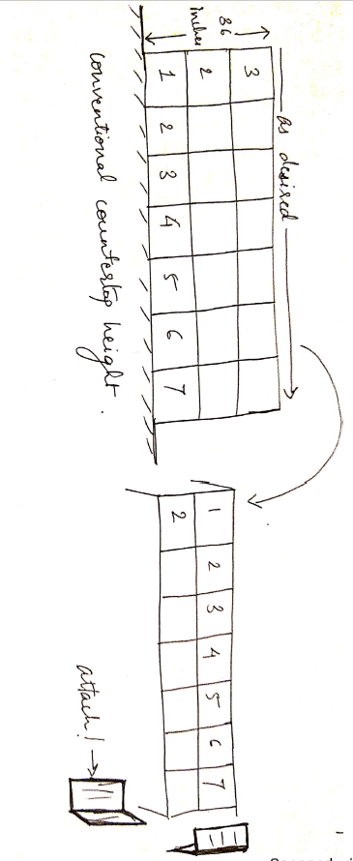
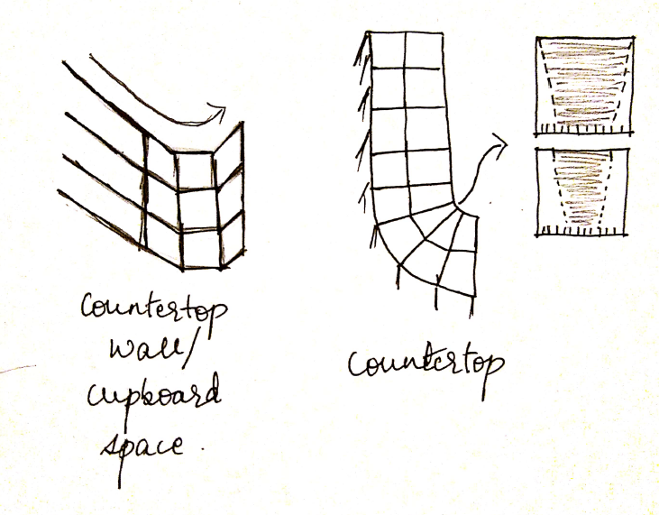
Sketching
Straight surfaces
Curved surfaces
With the conventional height of 36 inches.

Slide 12
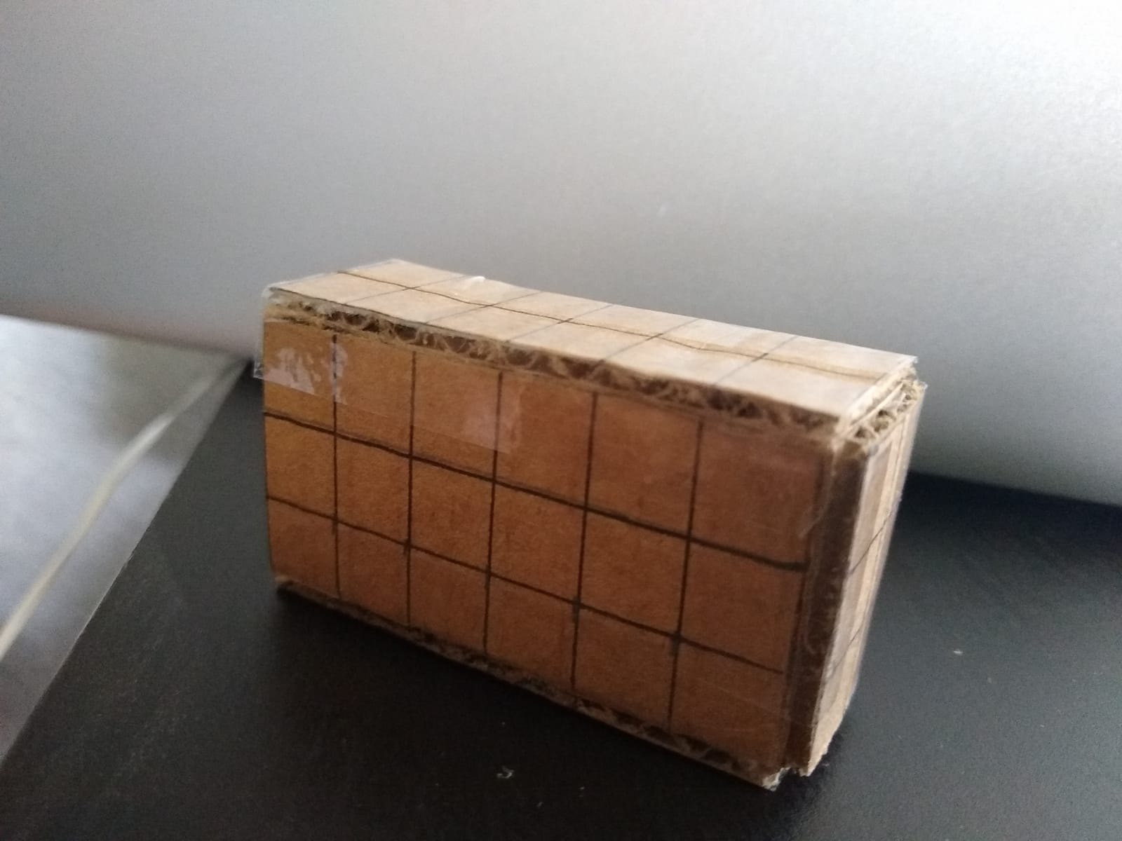
Prototype

Slide 13
Issues highlighted by Prototyping
Curved surfaces would take a lot more manual effort

Slide 14
Individual pieces

Slide 15
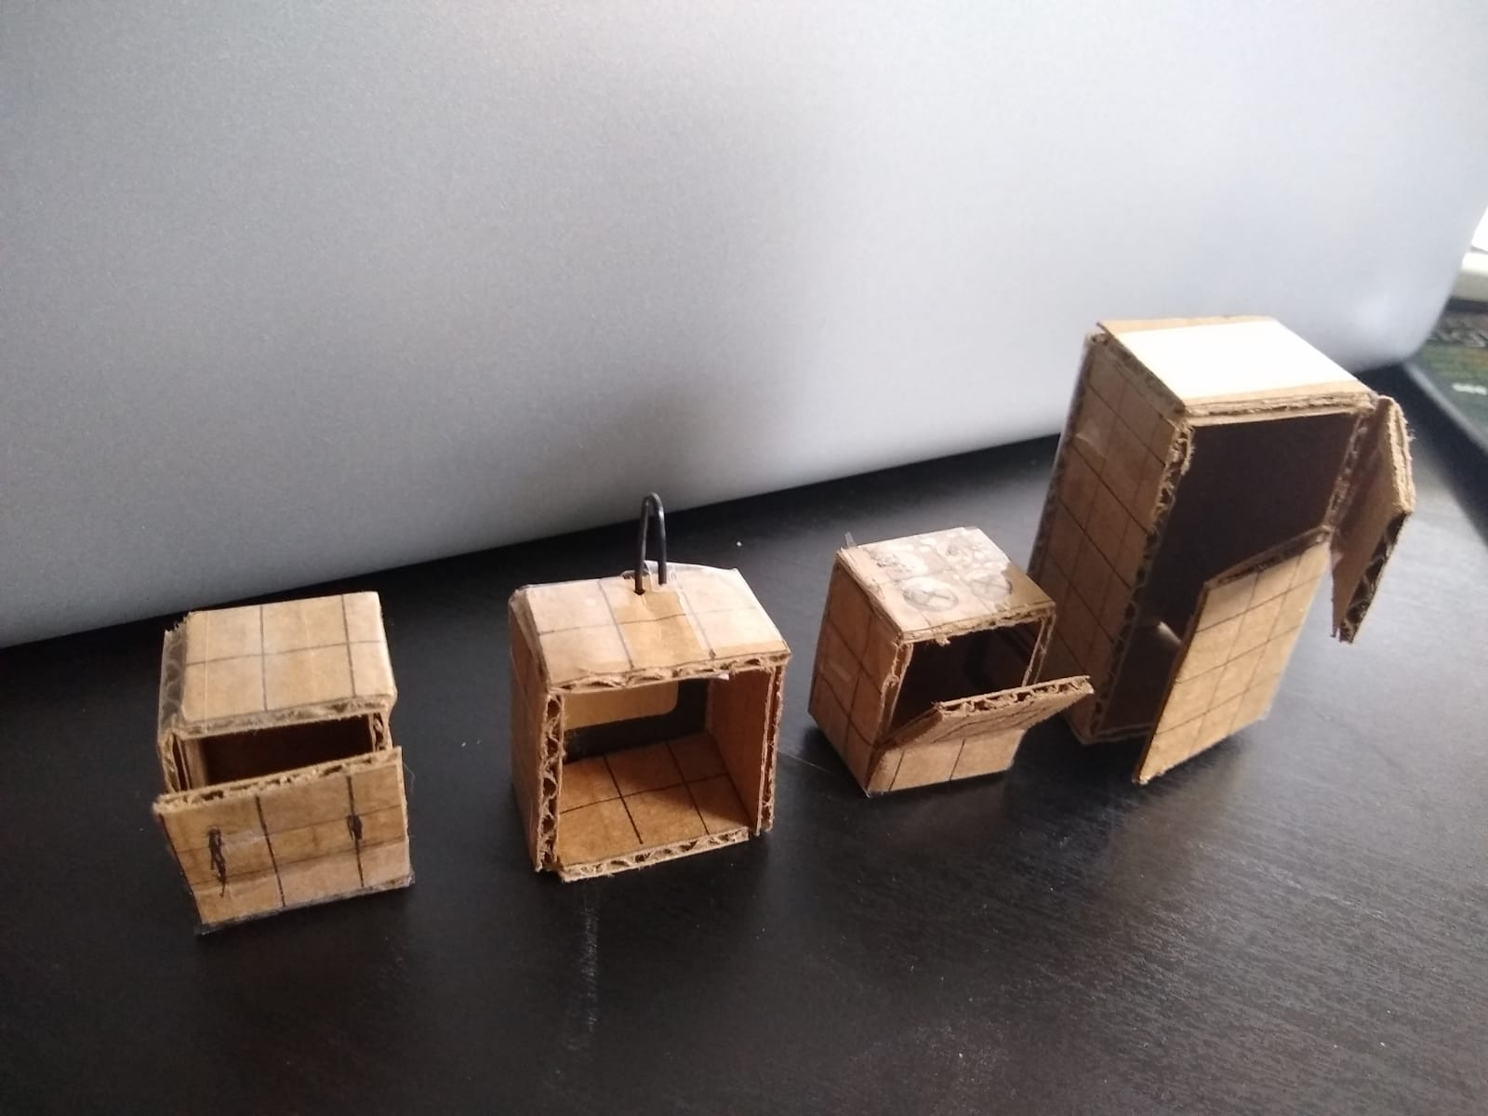
Prototype
Built with standard sizing.

Slide 16
Issues highlighted by Prototyping
Once again, each individual block must be able to bear weight and stand vertical
The “attachment” used here was simple cello-tape. The attachment in the actual product should be able to stick to the surfaces automatically. Which is why magnets was the first choice. Velcro has two components and if the attachment comes with one, the other surface must have the other component in the (difficult to anticipate) right spots.

Slide 17
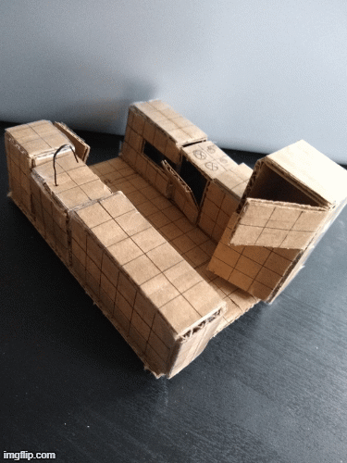
Sample

Slide 18
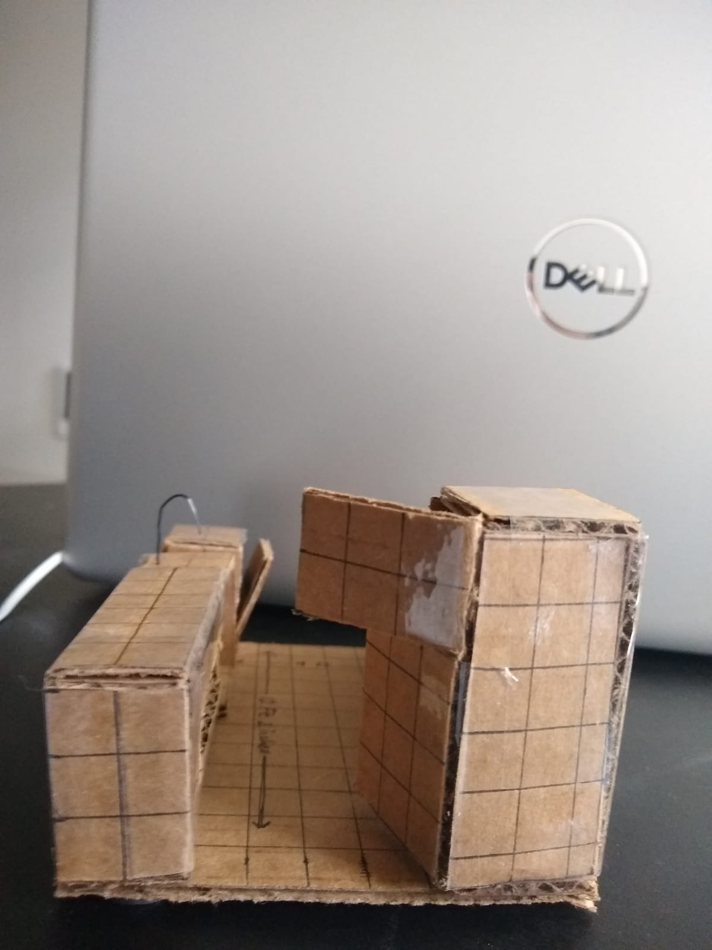
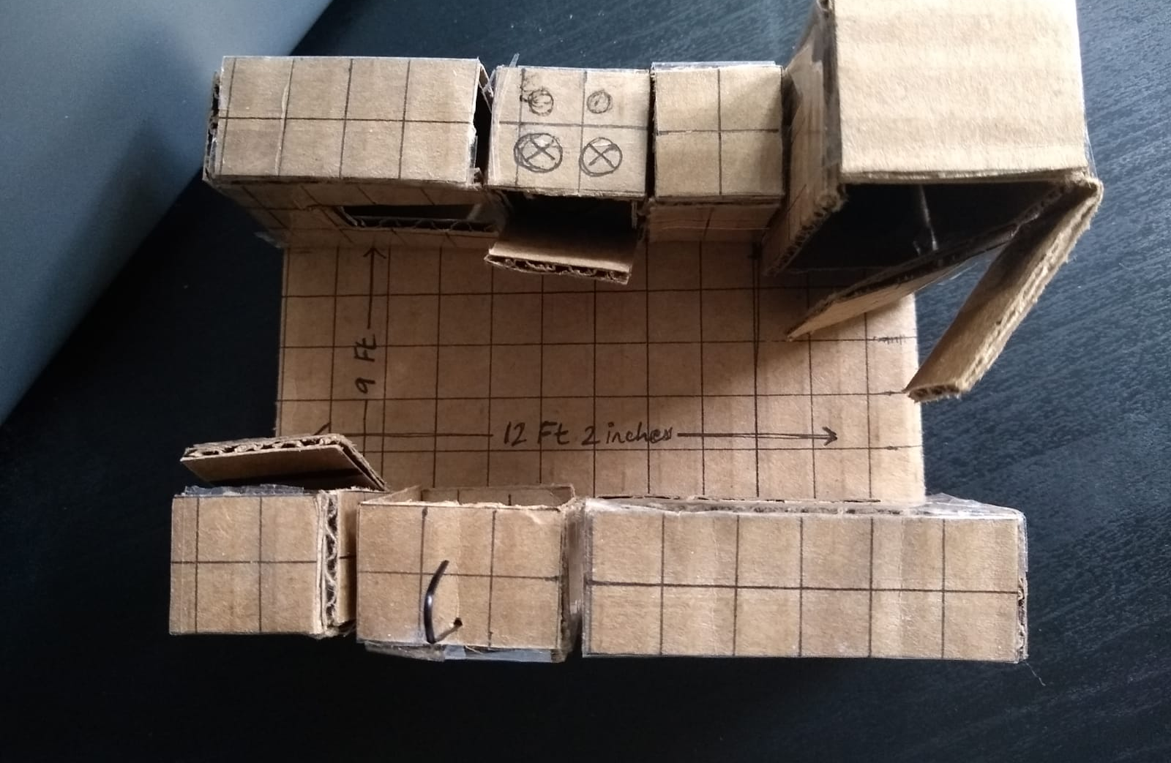
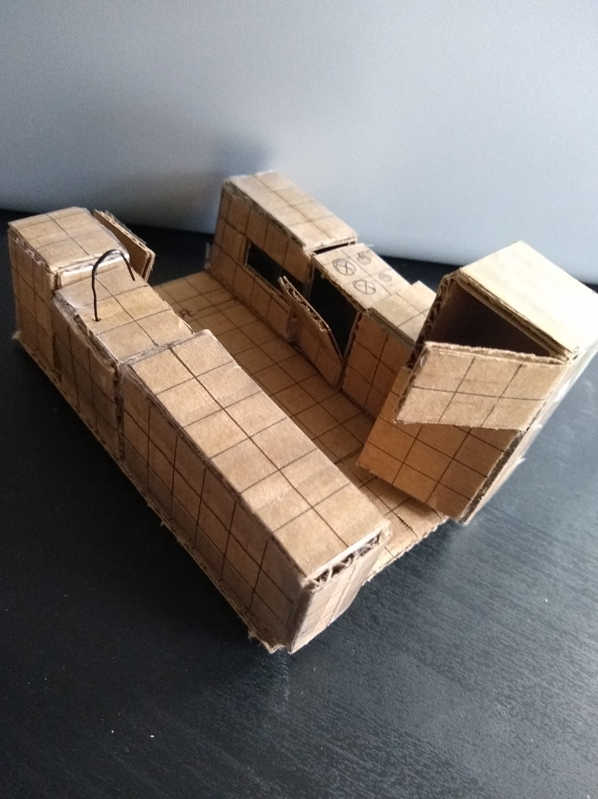
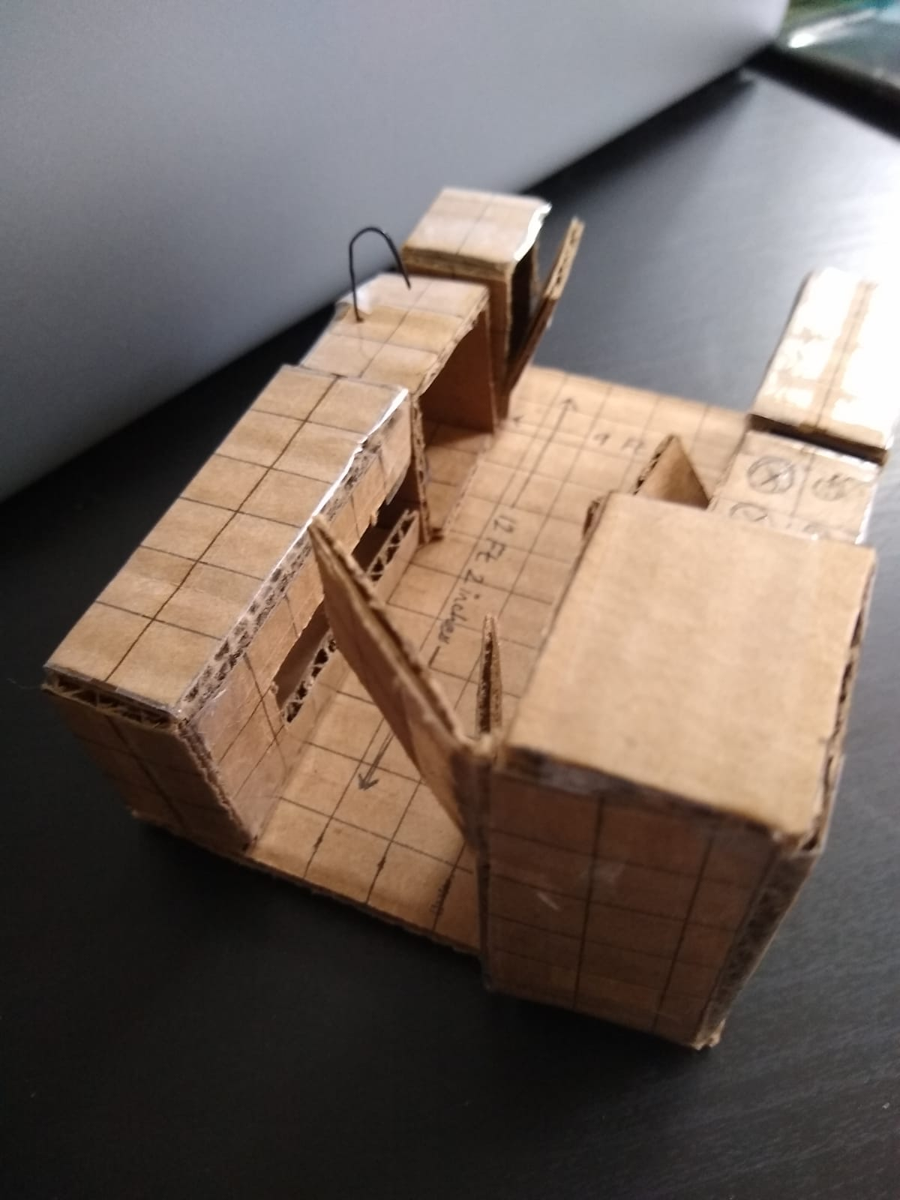
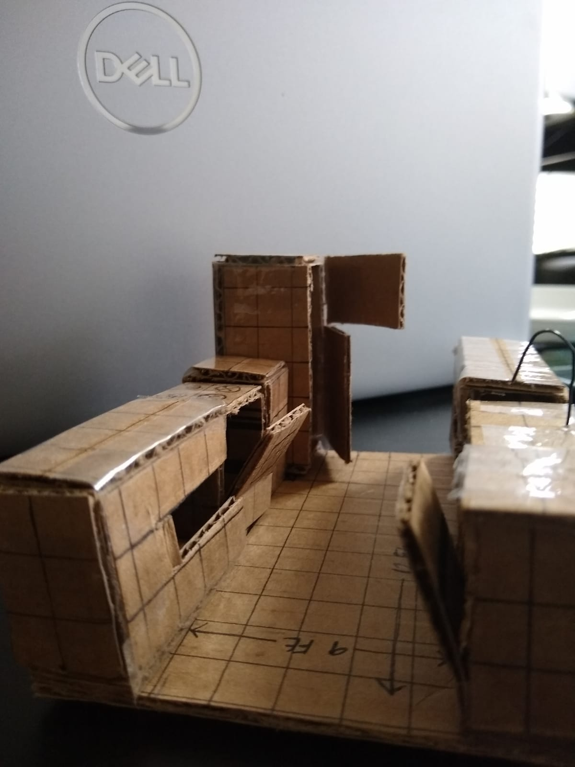

Slide 19
Testing pieces

Slide 20
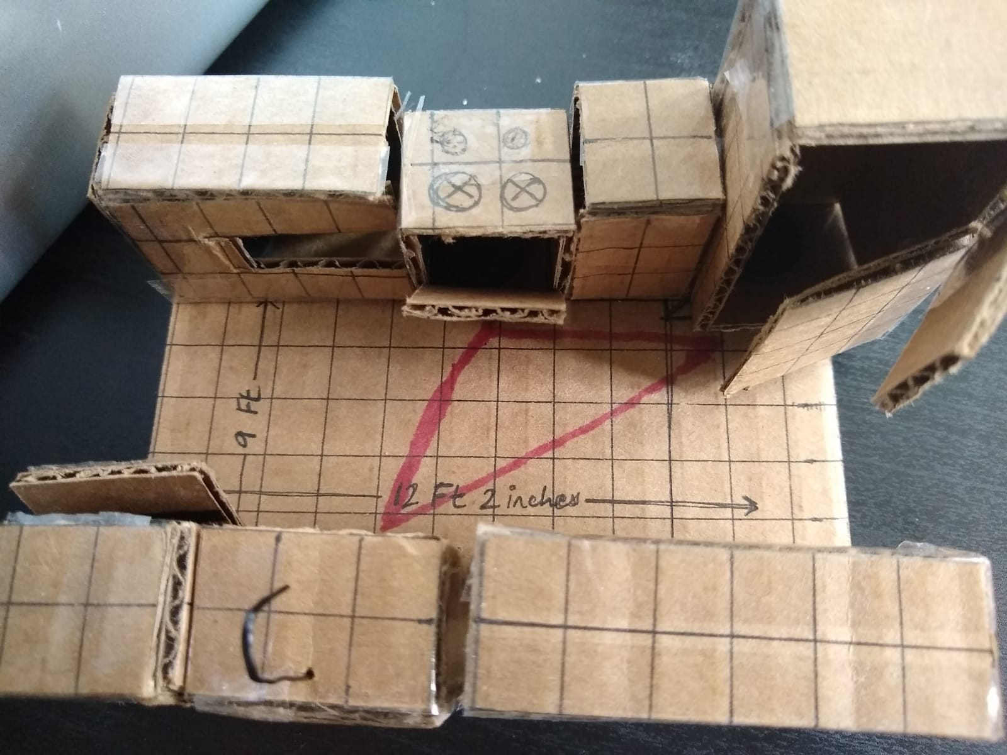
Test 1: Kitchen “Triangle”
Each edge should be more than or equal to 4 feet and less than or equal to 9 feet.
Here: 4 feet – 6 feet – 4.2 feet
Other such guidelines

Slide 21
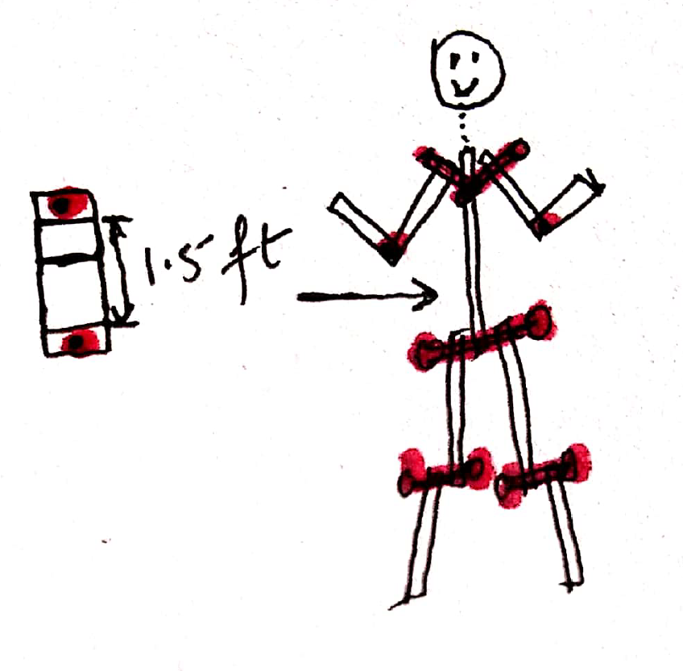
Test 2: Ergonomic Guide
Guide with how to take measurements.
Tape, pen, note to measure
Pieces to create a replica of a person at the dimensions that fit the model
Nuts and bolts to mimic joints
Cable Tie to mimic the neck?

Slide 22
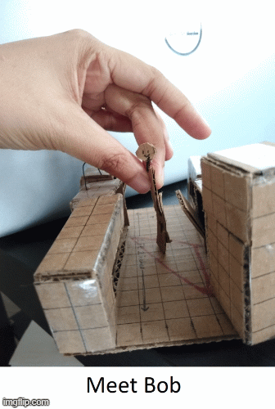

Slide 23
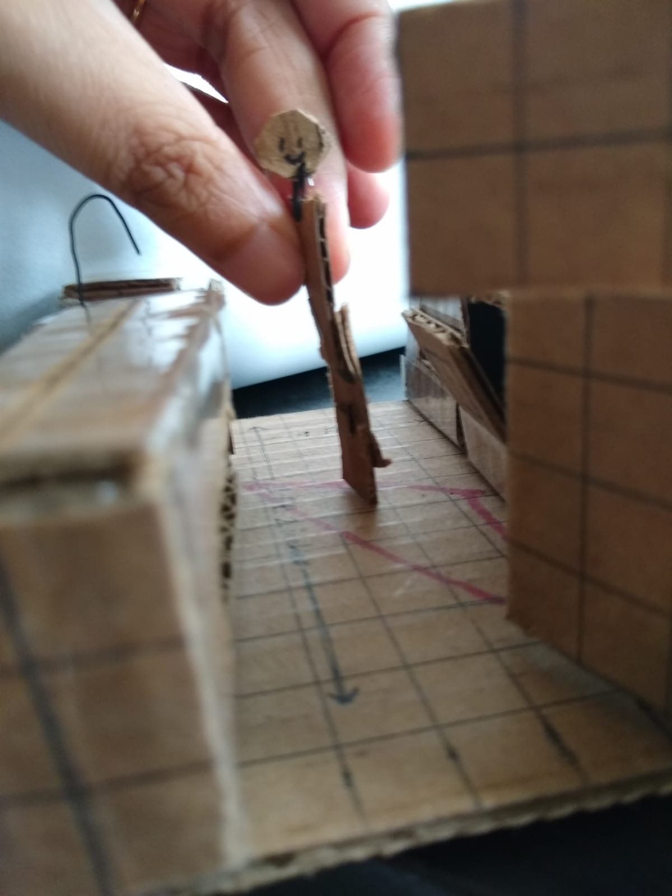
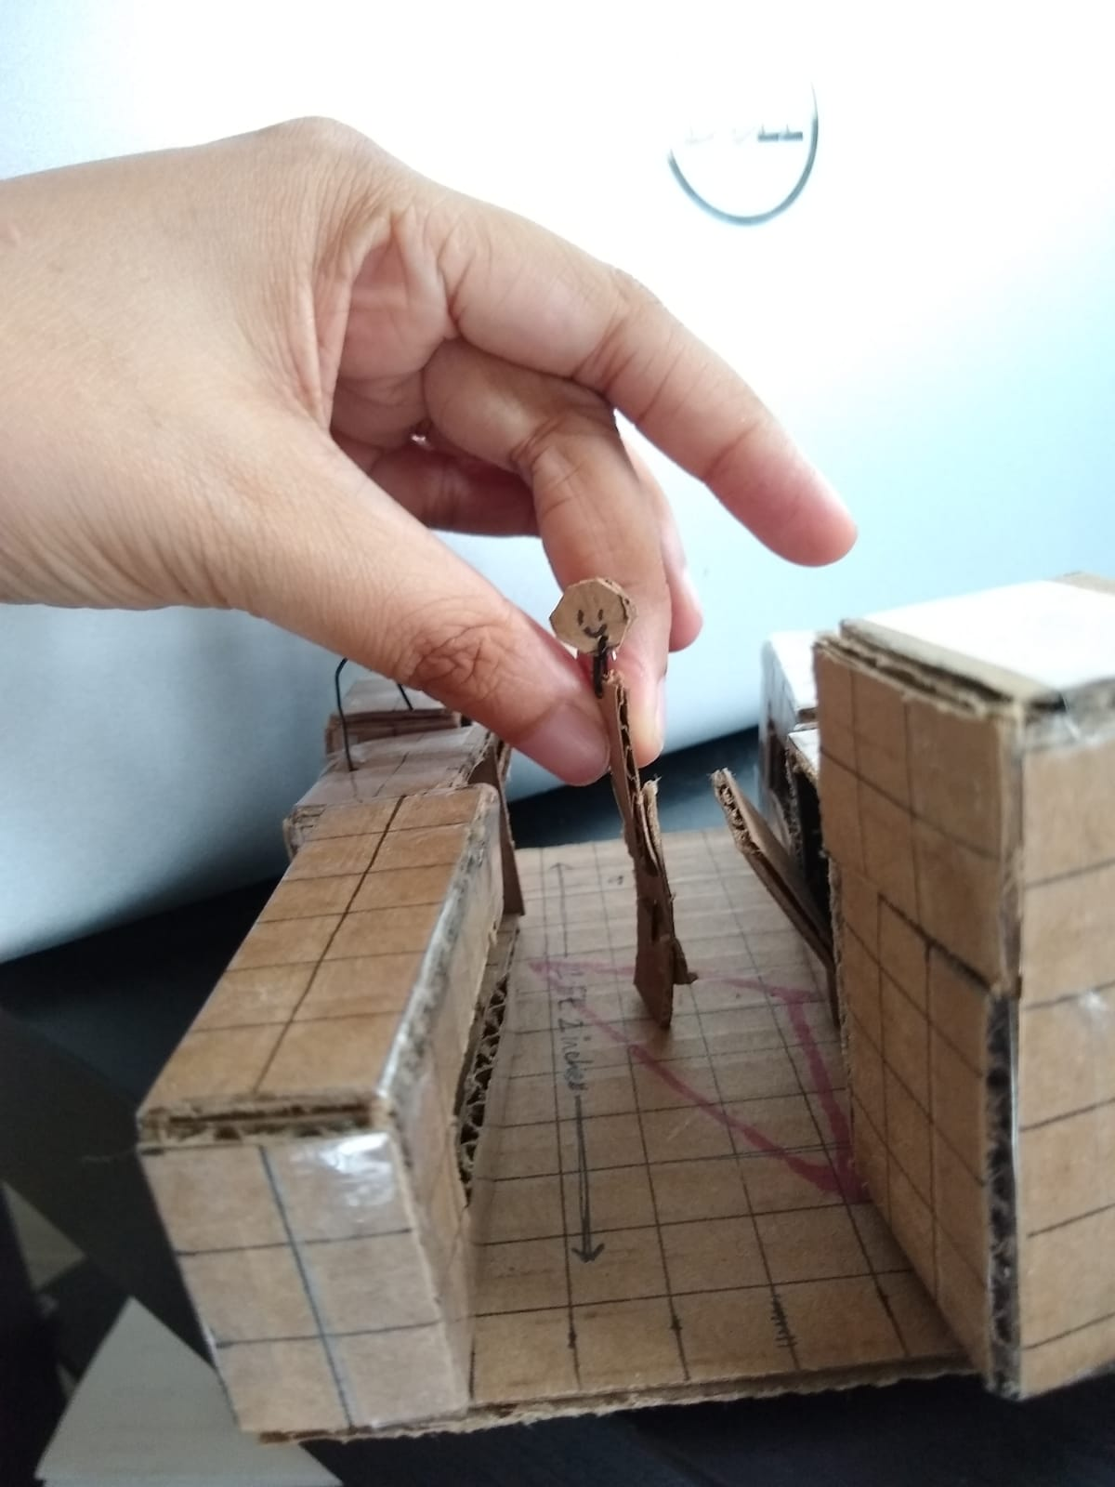
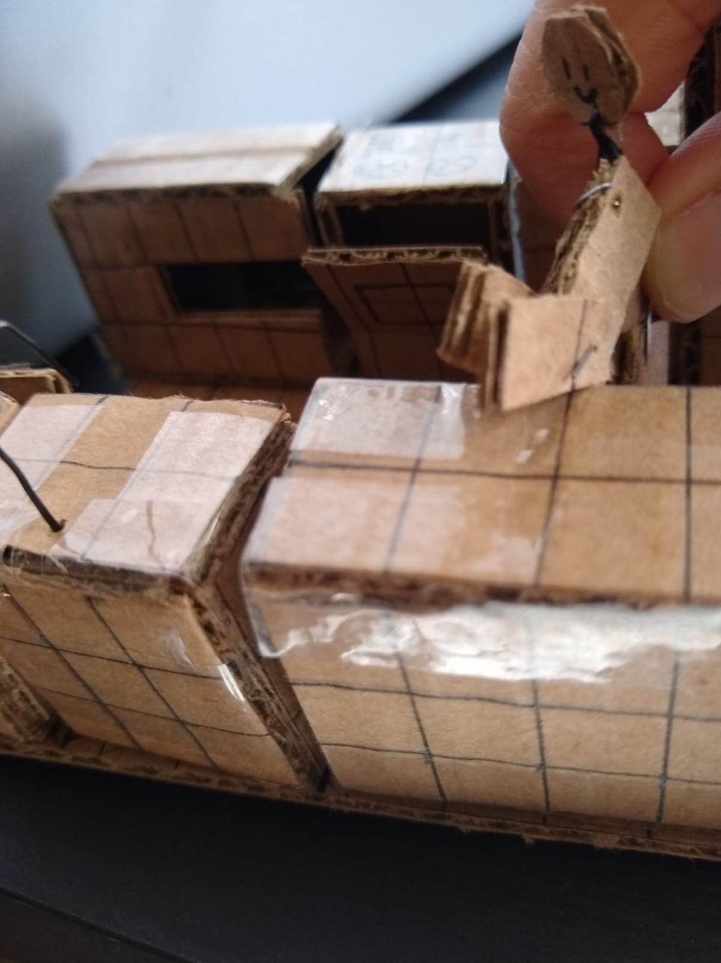
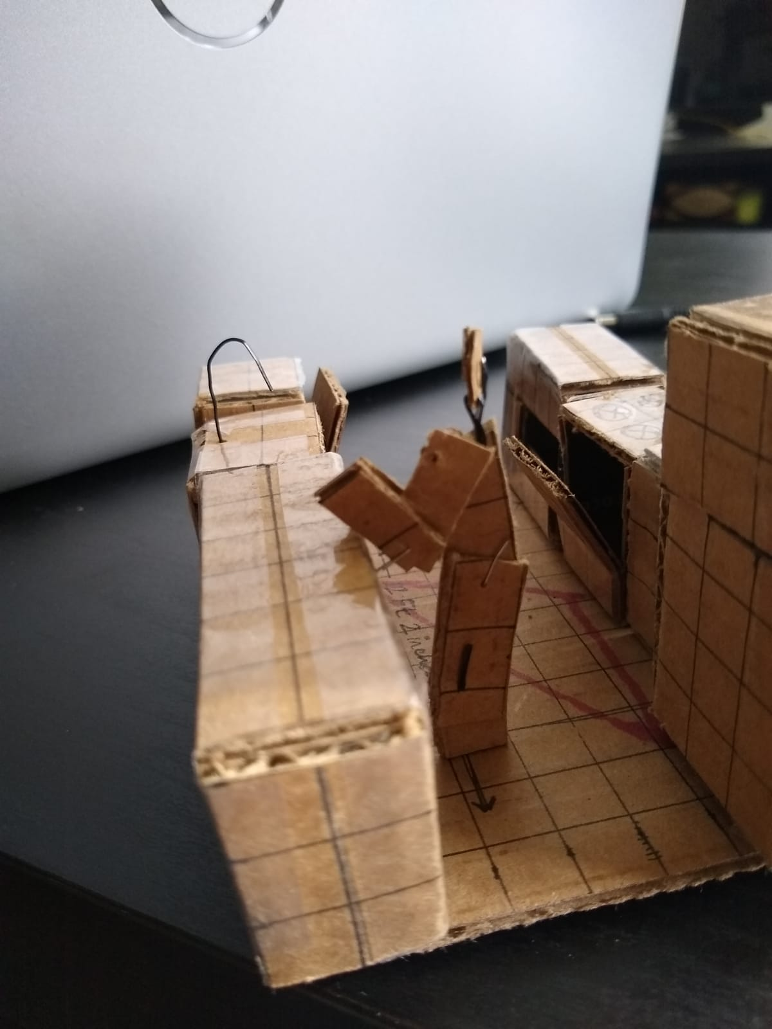
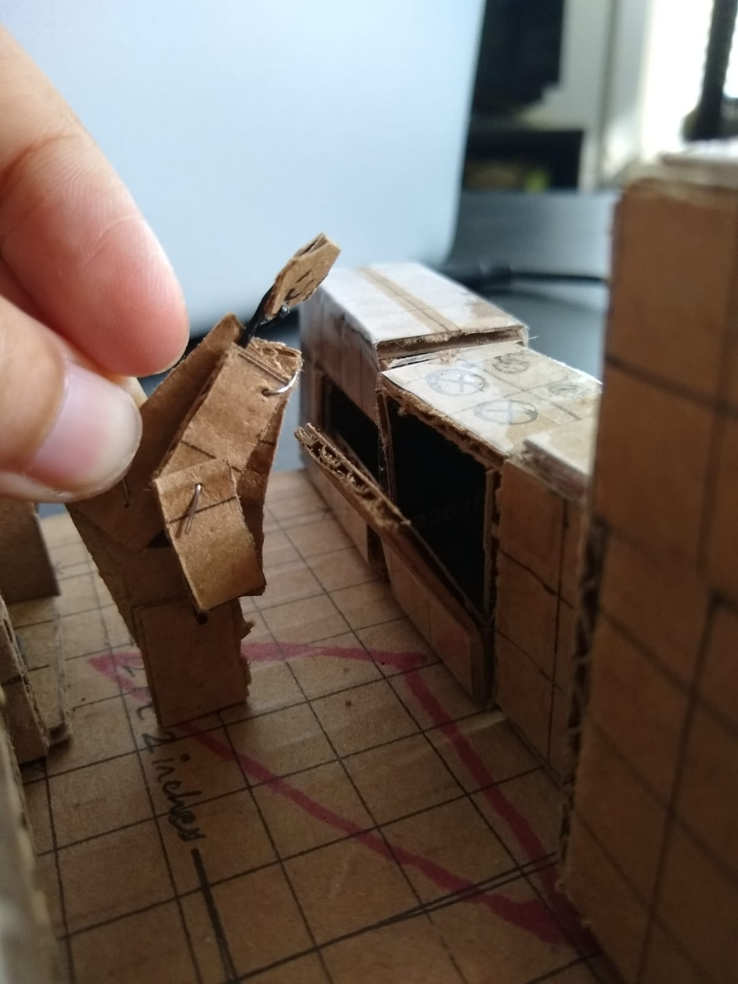
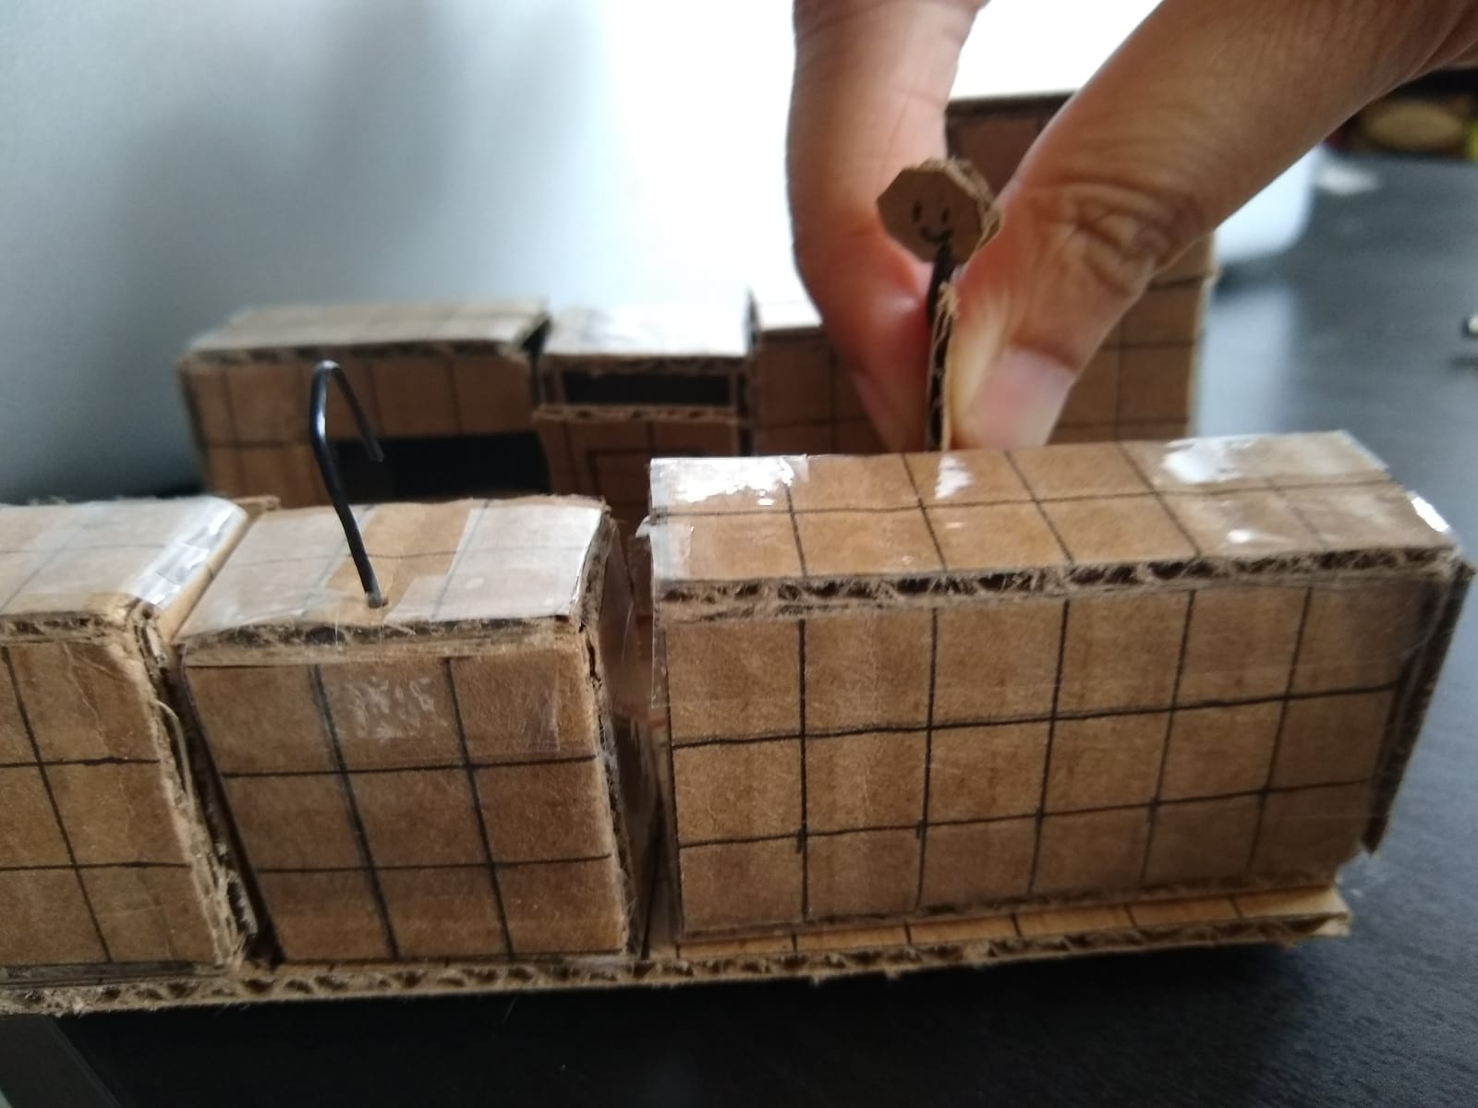
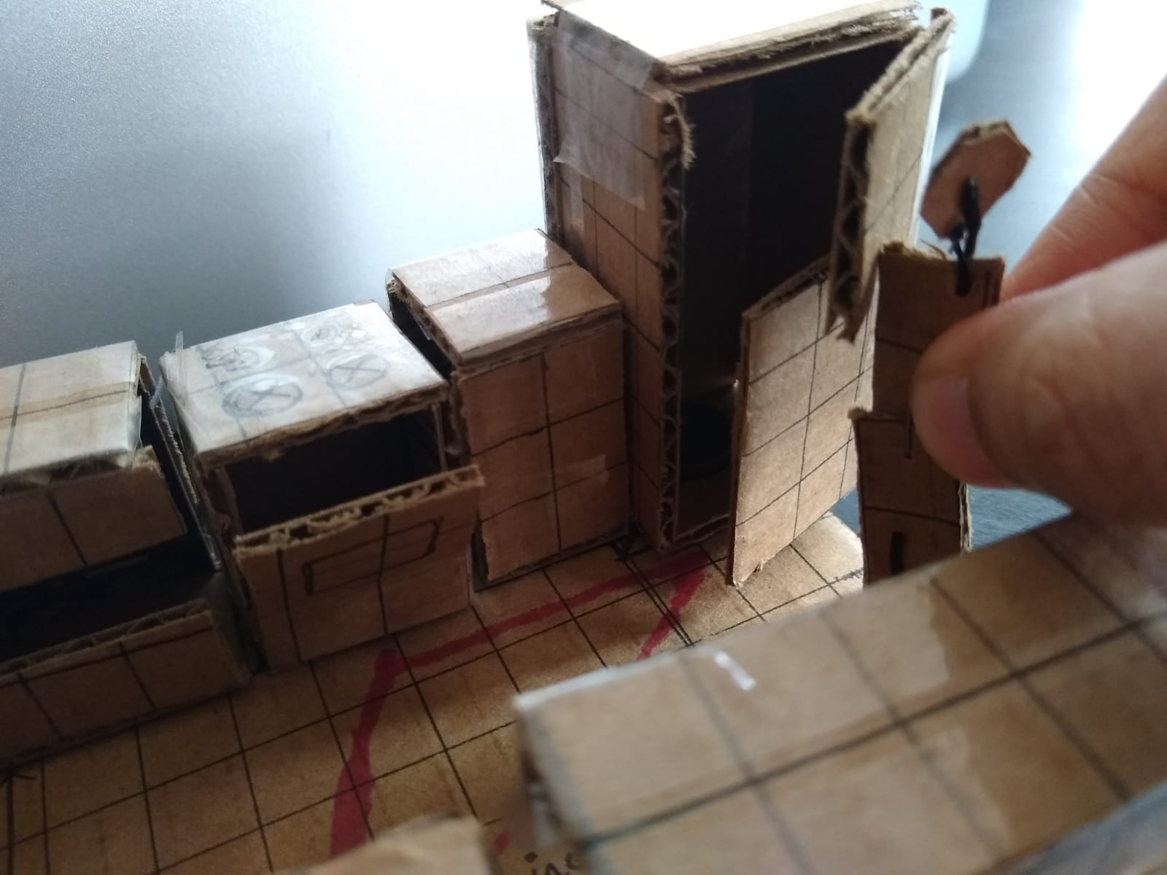
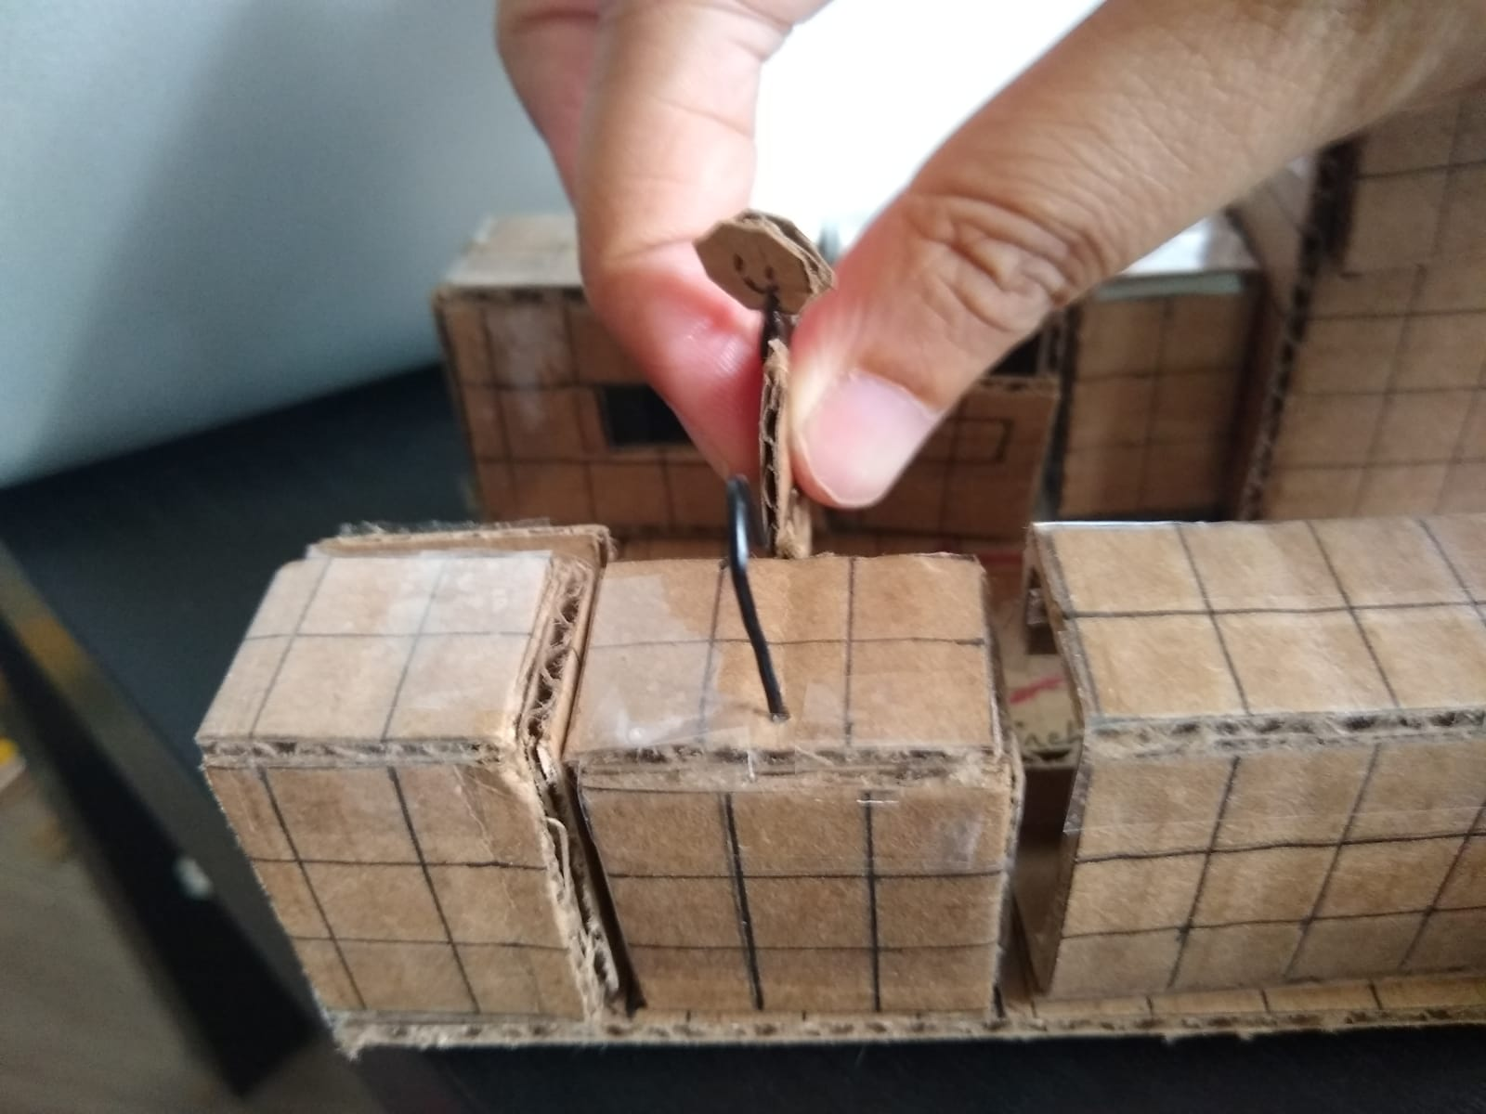
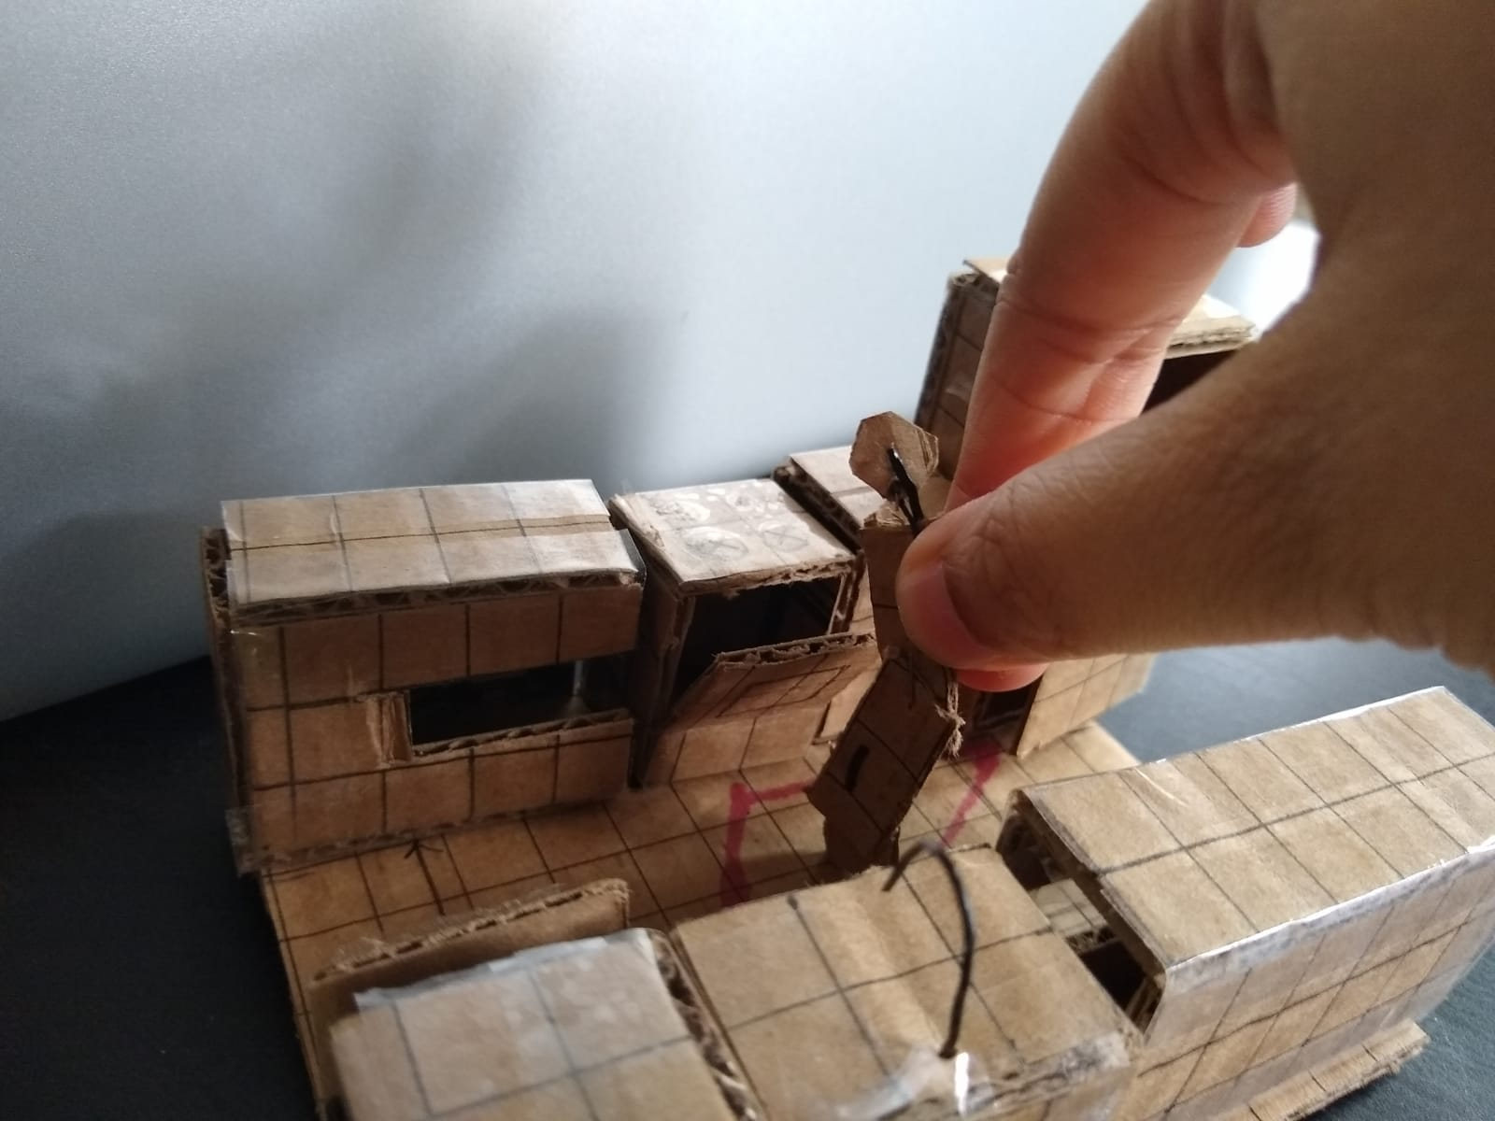

Slide 24
Issues highlighted by Prototyping
Need to account for the overlap where the nut and bolt go in, to the overall height of a person

Slide 25

Kit

Slide 26
1. Floor:
- Basic building blocks
2. Countertop
Basic building blocks
Attachments
Pre-built cabinets
3. Individual Items
Fridge
Oven
Microwave
Sink
Dishwasher
4. Test
The Kitchen “Triangle” test
The Ergonomic test
TOOLS
Wheels
linkages
Flexible wires
Flexible tubes
Magnetic strips
Hooks
Clamps
LED light
Playdough
Labels
Sketch pens
Pins
Glue
Double-sided tape
Exacto knife
Step 1: Open Box 1 and Tool Box, and use the building block to create a floor. Each building block is equivalent of 1 square feet. Use that to guide your measurements.
Step 2: Create a 2D floor plan using material from Tool Box to mark out the areas that will be covered by cabinets/fridge/sink etc.
Step 3: Open Box 2 to get the pre-built countertop/cupboards, built in conventional measures
Step 4: Use material from Tool Box to mark, cut or add building blocks to increase/decrease the size, or shape.
Step 5: Place them over the floor plan. Optionally use the magnets/glue/tape to stick them to the floor
Step 6: Like step 3, 4 and 5, open Box 3 to get the pre-built kitchen items with conventional sizes. Customize the dimensions. Place them over the floor plan
Step 7. Open Box 4. This contains two Test Sets.
7a: Kitchen Triangle test. Place pins on spots that are most frequented during cooking. Tie thread to form edges. 4 < Each edge < 9, and no outside traffic passing through
7b: Create a replica of yourself, with pieces attached at joints. Move the replica around and check against ergonomic standards (attached)

Slide 27
Thank you! Questions?

